Slide 1
Chatops: Ai powered devops
(NextGen DevOps)

Slide 2
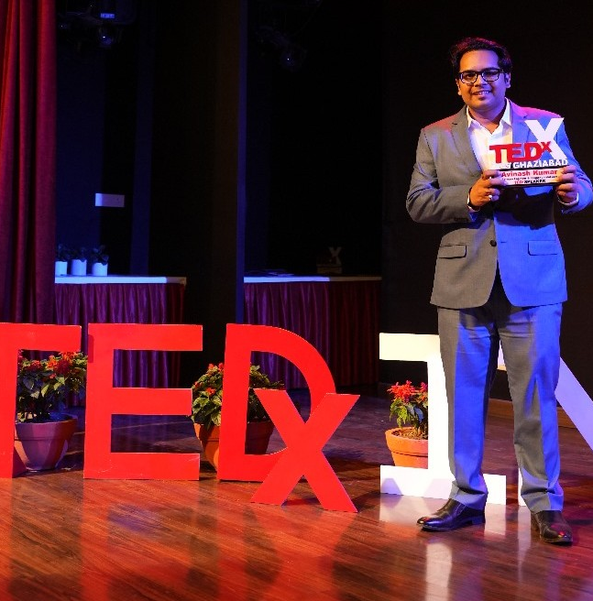
Avinash Kumar
10+ years of experience as a Developer, DevOps engineer, SRE engineer and born leader
Currently serving as Vice President @ MSCI Inc.
M.Tech. from BITS Pilani
MBA from IIT Patna
PG Diploma from IIIT Delhi
Executive Education from IIM Jammu
Guest Lecturing @ BITS Pilani & IIT Patna
Interested in Public Speaking, Biking, Tarot Reading, Astrology, Understanding Mythology, Traveling, Cooking
Skill Sets: Java, Python, Agentic AI, Gen AI, CI/CD Tools, Azure Cloud, Terraform, SRE, Linux, and much more
Created an open source terraform provider for making API calls
Social Media Influencer
Contact#: +91-7877273088
LinkedIn: https://www.linkedin.com/in/avinashmishrainviul

Slide 3
AGENDA
Introduction
Agentic AI
Intro to LangGraph
Designing AI Agents
RAG in Action
Design Patterns for AI-Driven DevOps
Demonstration
Benefits of AI-Driven DevOps
How to build AI Agent?
Challenges & Mitigations
Future of AI in DevOps
CTA (Call to Action)
Q&A

Slide 4

team struggling with multiple tools, Slack messages, and manual processes

Slide 5
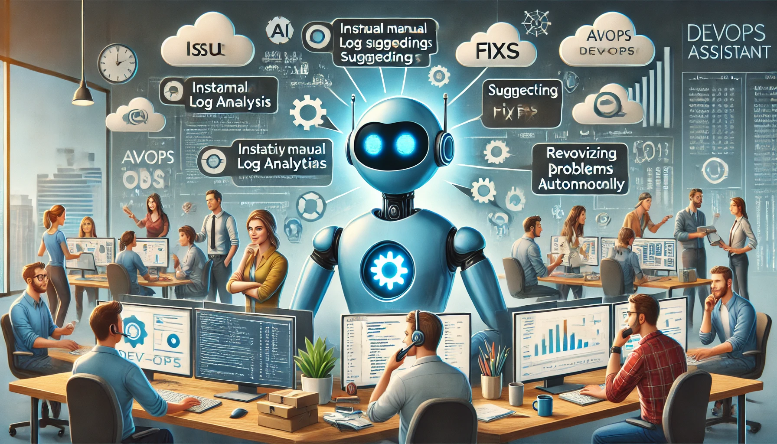
AI powered Assistant
Instantly Identifies Issues
Suggest Fixes
Resolves it autonomously

Slide 6
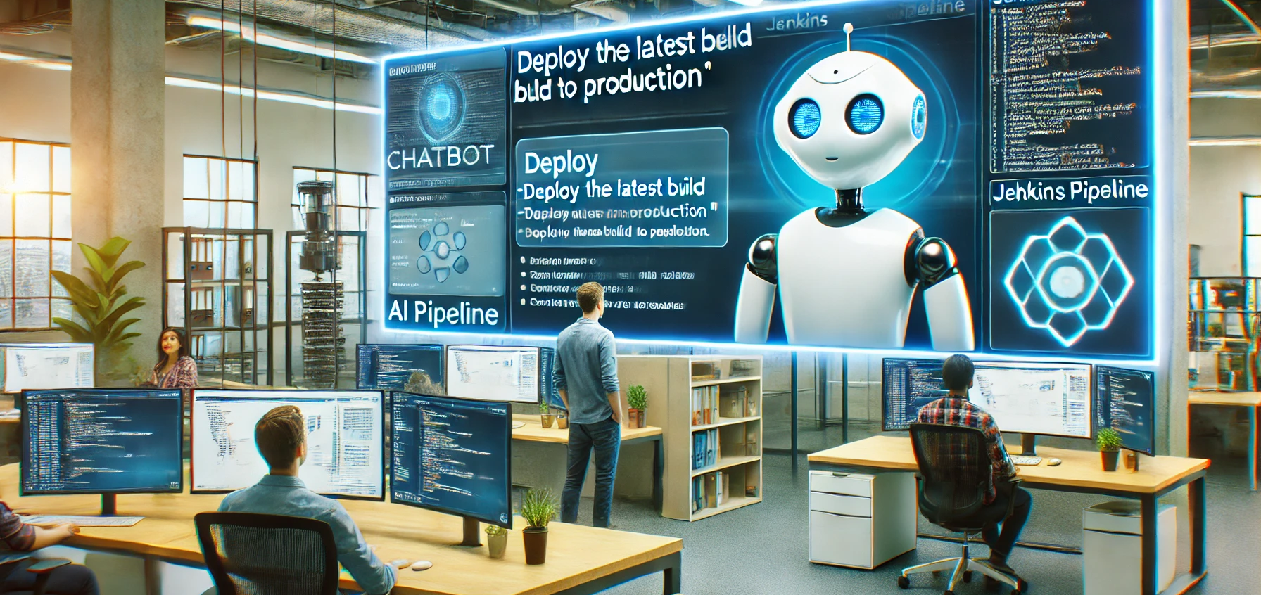
Introducing AI in devops
Super-Smart Assistant
Automate Tasks
Real time Insights
Predict Issues

Slide 7
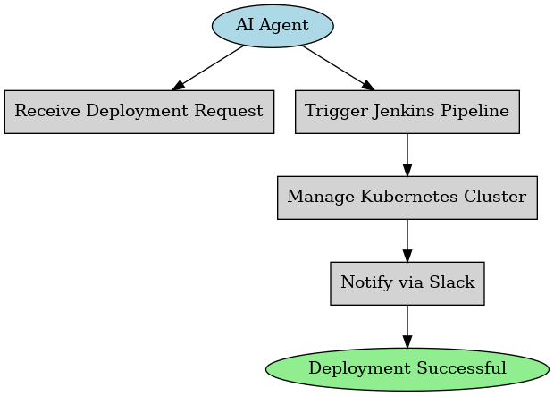
What is agentic Ai?
Agentic AI is an AI system that:
can act autonomously
Makes decision
can perform without constant human intervention
It can:
Trigger CI/CD pipelines
Monitor logs and alert you about anomalies
Resolves incident by rolling back deployments
Scaling resources
DevOps Engineer who’s Always on Call

Slide 8
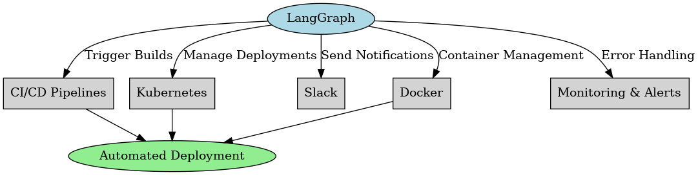
Langgraph for agentic AI chatbots

Slide 9
With langgraph,
You can-
Integrate with DevOps Tools: Connect to Jenkins, Kubernetes, Terraform, etc.
Automate Workflows: Deploy code, monitor systems, and manage incidents.
Provide Insights: Analyze logs and suggest optimizations.

Slide 10
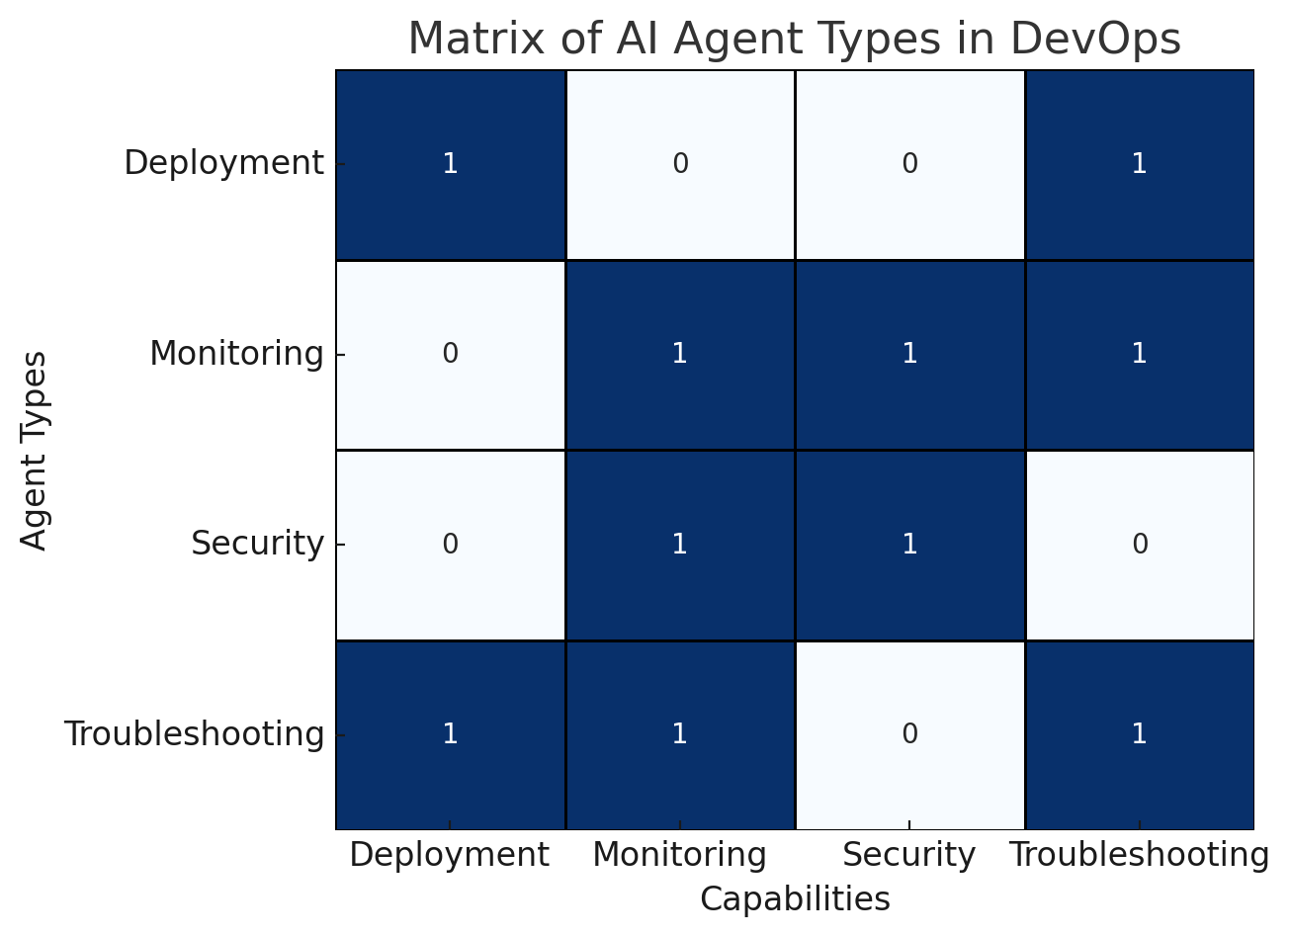
Designing AI agents for devops
Deployment Agent: Triggers pipelines, validates configurations, rolls back on errors.
Monitoring Agent: Analyzes logs, predicts anomalies using ML, alerts humans only when needed.
Troubleshooting Agent: Uses RAG to pull docs and past incidents, suggests fixes.
Security Agent:
Scans for vulnerabilities pre-deployment. These agents work like a pit crew—specialized, fast, and precise."

Slide 11
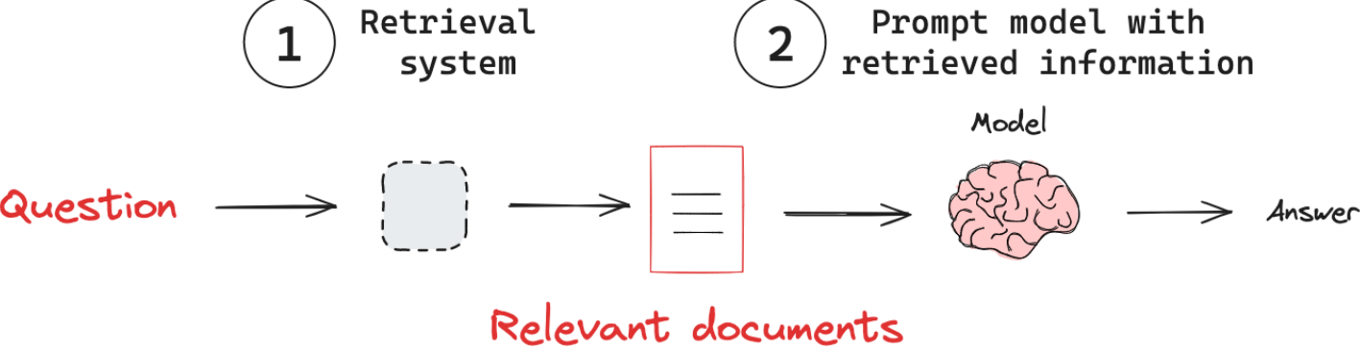
RAG (Retrieval-Augmented Generation) in Action
Context Aware Intelligence
The RAG-powered bot pulls internal docs, past incident reports, and Grafana dashboards.
Example: A developer asks, ‘Why is the API latency spiking?’
It answers: ‘Latency spiked due to a memory leak in v1.3. Fix: Apply patch #123.’ No more digging through Slack history—RAG turns chaos into clarity."

Slide 12
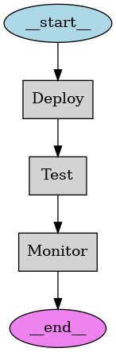
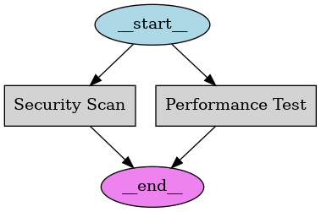
Design pattern for ai driven devops
1. Sequential Chaining :
Deploy → Test → Monitor (strict order)
2. Parallel Execution :
Security Scan + Performance Test (save time)

Slide 13
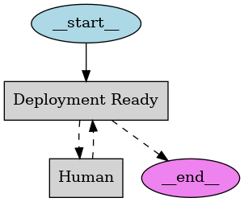
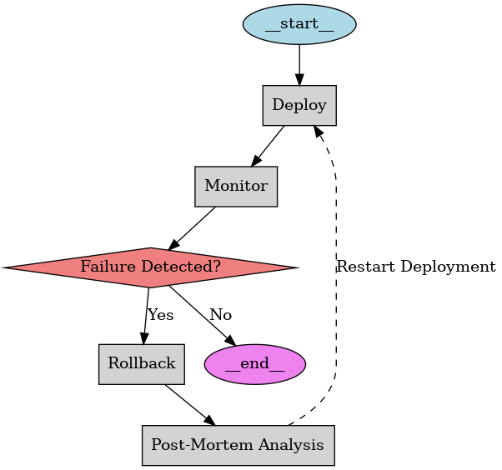
Continues…
3. Human-in-the-loop:
Production deployment ready. Approve?
4. Self-healing:
Auto-rollback on failure + trigger post-mortem analysis

Slide 14
DEMO

Slide 15
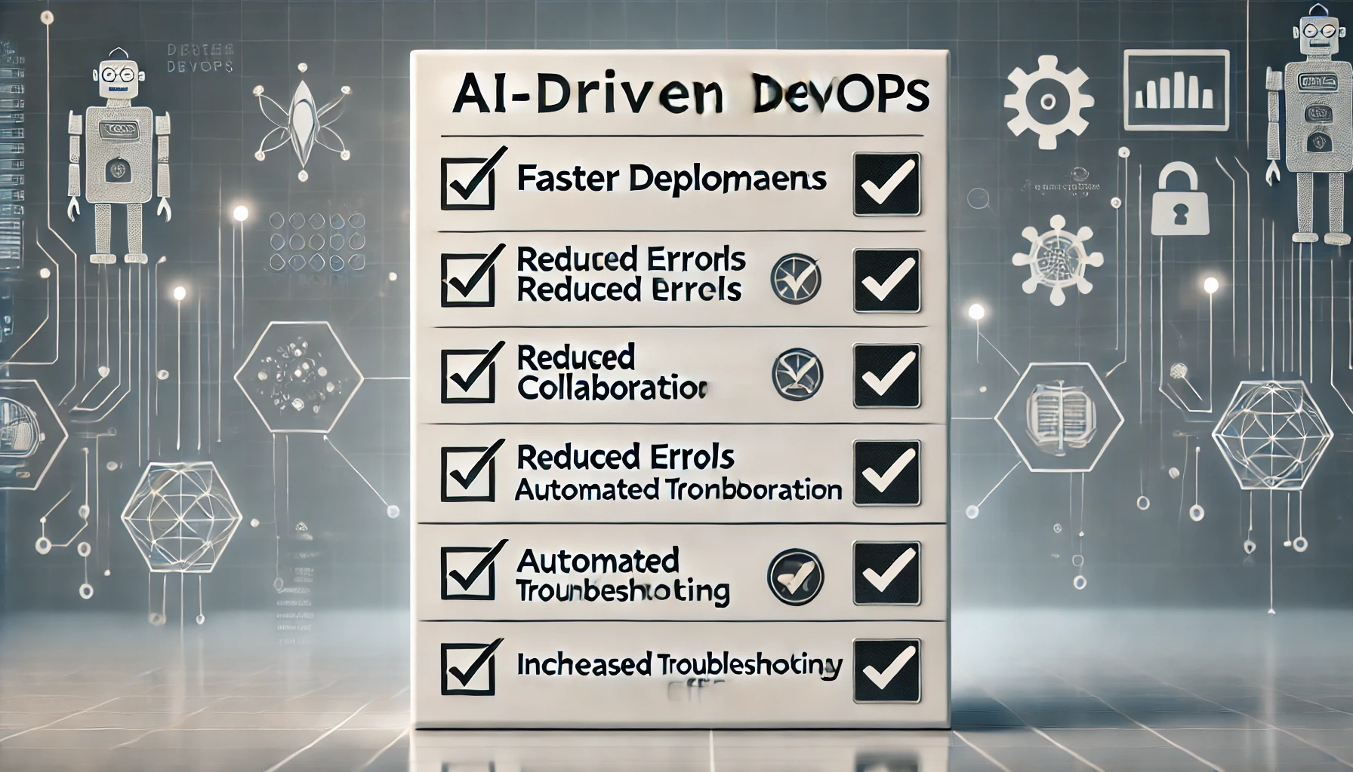
Benefits of AI driven devops
50% Faster Deployments: No more waiting for human reviews.
70% Fewer Incidents: AI predicts and resolves issues.
24/7 Operations: Agents never sleep.
But How do you get started?

Slide 16
Building your first ai agent
Pick a Repetitive Task: Like rolling back failed deployments.
Define the Agent: Use LangGraph to connect to Jenkins and monitoring tools.
Add Guardrails: Human approval for production changes. Tools like LangGraph, LlamaIndex, and OpenAI’s APIs make this easier than ever."

Slide 17
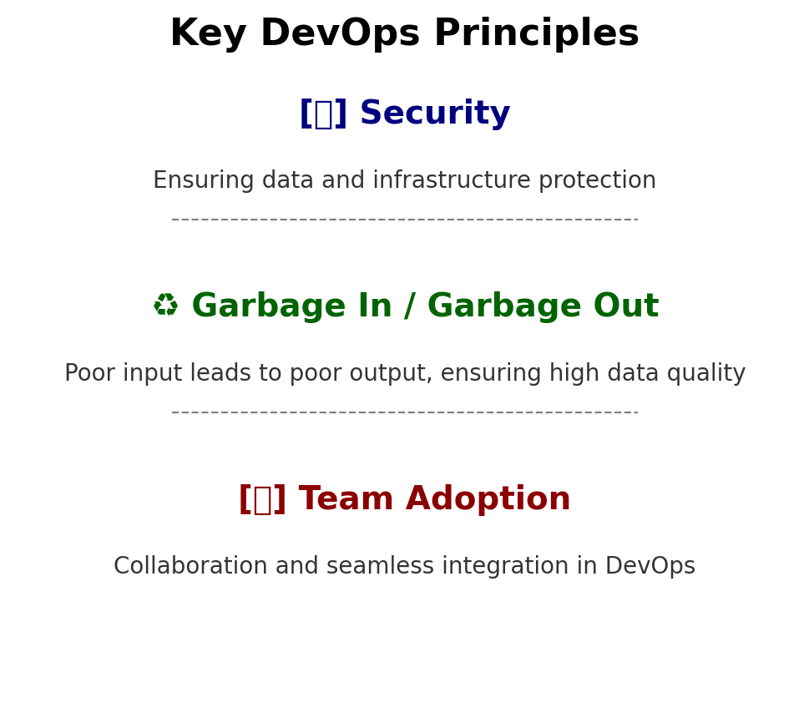
Challenges & mitigations
AI DevOps isn’t without challenges:
Security: Keep credentials secure with tools like Vault.
Data Quality: Train agents on clean, structured logs.
Adoption: Start with non-critical tasks to build trust. The key? Iterate, monitor, and scale gradually."

Slide 18
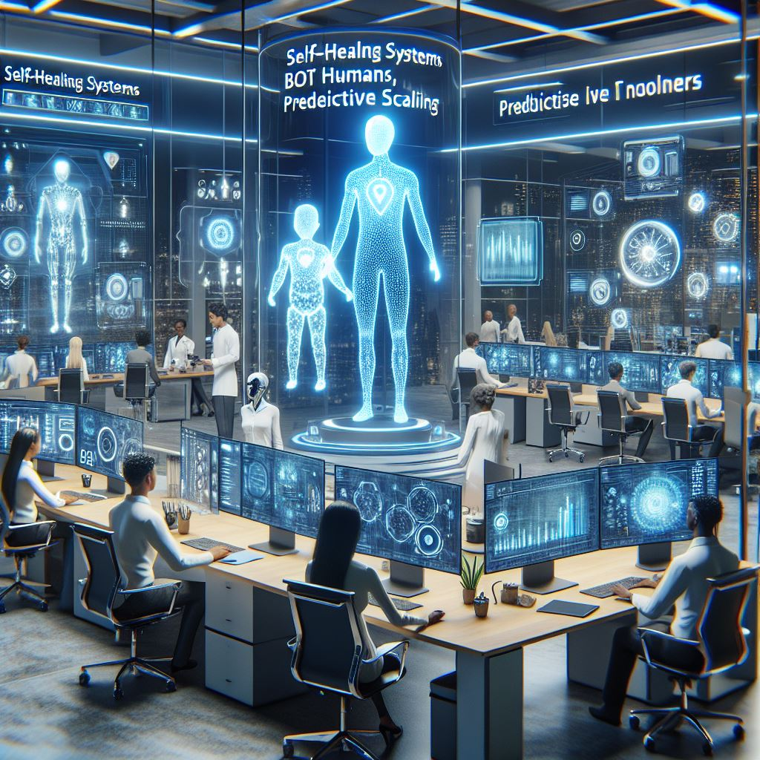
Future of AI in Devops
Self-Healing Systems: AI auto-fixes incidents before you notice.
AI Pair Engineers: Code reviews, infrastructure design, and more.
Predictive Scaling: Cloud resources adjust before traffic spikes.
The future isn’t just automated—it’s anticipatory."

Slide 19
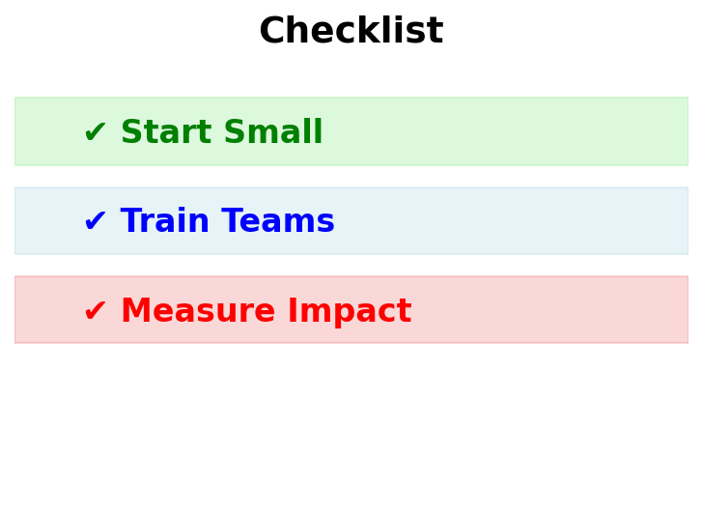
Call to action
Your roadmap to AI-Driven DevOps:
Identify Pain Points: Start with logging or deployments.
Experiment with LangGraph: Build a simple agent in 1 day.
Measure ROI: Track deployment speed, MTTR, team satisfaction.
The future belongs to those who automate intelligently."

Slide 20
Q ‘n’ A

Slide 21
Thank you
Dr. (h.c.) Avinash Kumar
+91-7877273088
bloggeravinash786@gmail.com
www.inviul.com

